Slide 1
Biology
Sylvia S. Mader
Michael Windelspecht2
Chapter 27
Flowering Plants: Reproduction
Lecture Outline
See separate FlexArt PowerPoint slides for all figures and tables pre-inserted into PowerPoint without notes.
Copyright 2022 © McGraw Hill LLC. All rights reserved. No reproduction or distribution without the prior written consent of McGraw Hill LLC.

Slide 2
Outline
27.1 Sexual Reproductive Strategies
27.2 Seed Development
27.3 Fruit Types and Seed Dispersal
27.4 Asexual Reproductive Strategies

Slide 3
27.1 Sexual Reproductive Strategies
Plants have a two-stage, alternating life cycle.
  The diploid sporophyte is dominant and produces haploid spores by meiosis.
    It is the portion of the life cycle that bears flowers.
  Flowers produces two types of spores: microspores and megaspores.
  Spores divide mitotically to become haploid gametophytes.
  Gametophytes produce gametes.
  Gametes fuse to produce a diploid zygote.
  Zygote divides mitotically to become the diploid sporophyte, which becomes a mature organism.

Slide 4
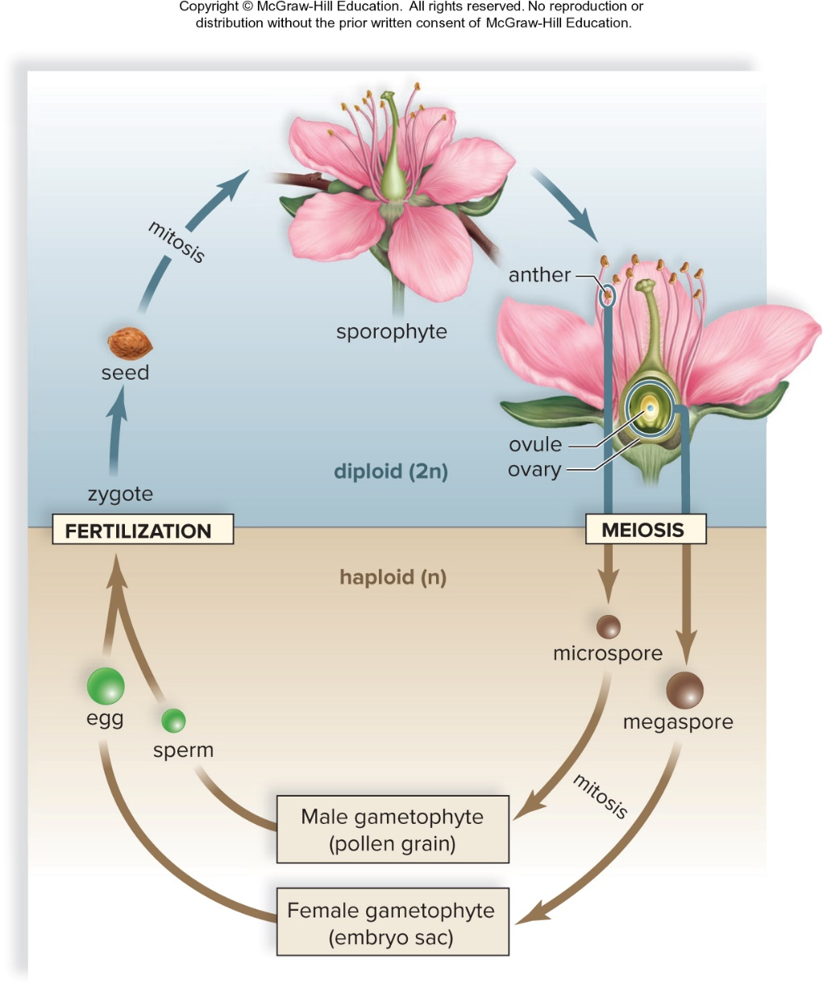
Sexual Reproduction in Flowering Plants
Figure 27.1
Access the text alternative for slide images.

Slide 5
Sexual Reproductive Strategies
A flower produces two types of spores.
  Microspore – Male gametophyte
    It undergoes mitosis.
    It becomes pollen grain.
  Megaspore – Female gametophyte
    It undergoes mitosis.
    It becomes the female gametophyte, an embryo sac within an ovule within an ovary.
    The ovule becomes a seed.
    The ovary becomes a fruit.

Slide 6
Flowers
  Unique to angiosperms
  Attract pollinators
  Produce fruits that enclose seeds
  Flowering occurs in response to environmental signals such as day length.
  In some plants, flowers develop when leaf-forming meristems stop producing leaves and start producing flowers in a bud.
    In monocots, flower parts occur in threes and multiples of three.
    In eudicots, flower parts occur in fours or fives and multiples of four or five.

Slide 7
Flower Structure
A typical eudicot flower has four whorls of modified leaves attached to a receptacle at the end of a flower stalk called a peduncle.
  Sepals protect the bud.
  Petals attract pollinators.
  Stamens are the male portion of the flower.
    Anther – Saclike container
    Filament – Slender stalk
  Carpel is the female portion of flower.
    Stigma – Enlarged sticky knob
    Style – Slender stalk
    Ovary – Enlarged base enclosing ovules
    Ovules – Play a significant role in the production of megaspores (female gametophyte)

Slide 8
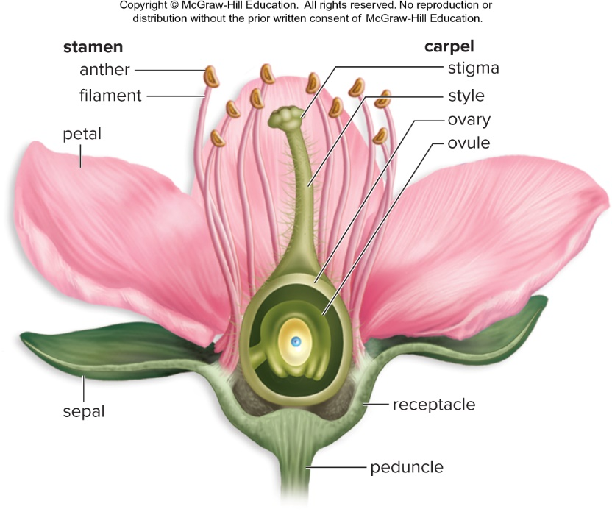
Anatomy of a Flower
Figure 27.2

Slide 9
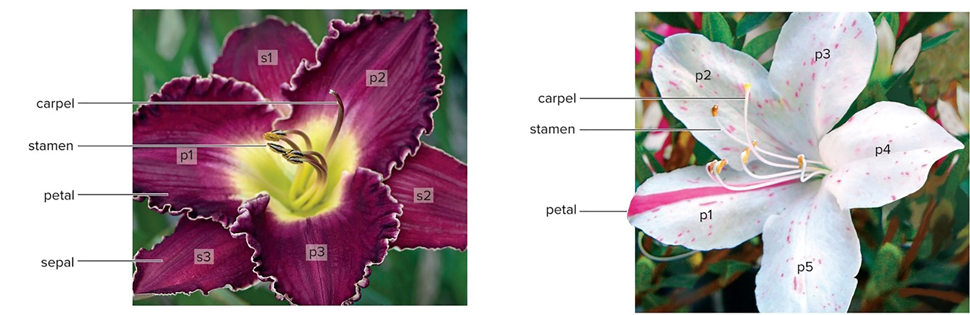
Monocot Versus Eudicot Flowers
Daylily, Hemerocallis sp.
Festive azalea, Rhododendron sp.
Figure 27.3
Access the text alternative for slide images.
(a): Marg Cousens/Getty Images; (b): Dr. Murray P. Pendarvis

Slide 10
Variations in Flower Structure
Complete versus incomplete flowers:
  Complete flowers have sepals, petals, stamens, and a carpel.
  Incomplete flowers are missing one or more of the above.
Perfect versus imperfect flowers:
  Perfect (bisexual) flowers have both stamens and carpels.
  Imperfect (unisexual) flowers have one but not the other.
Monoecious versus dioecious plants:
  Monoecious plants have staminate flowers and carpellate flowers on the same plant.
  Dioecious plants have staminate and carpellate flowers on separate plants.
    Holly trees are dioecious.
Notes:
HOME NOTE
• Monoecious vs dioecious
Also write here:
– Conifers (23.5.58): Conifers (e.g., pines) are monoecious: one tree makes both pollen cones (male) and seed cones (female).
– Cycads (23.5.70): Cycads are dioecious: pollen cones and seed cones grow on separate plants.
– Ginkgoes (23.5.72): Ginkgoes are dioecious: some trees make seeds, others make pollen.
• Complete/incomplete and perfect/imperfect flowers

Slide 11
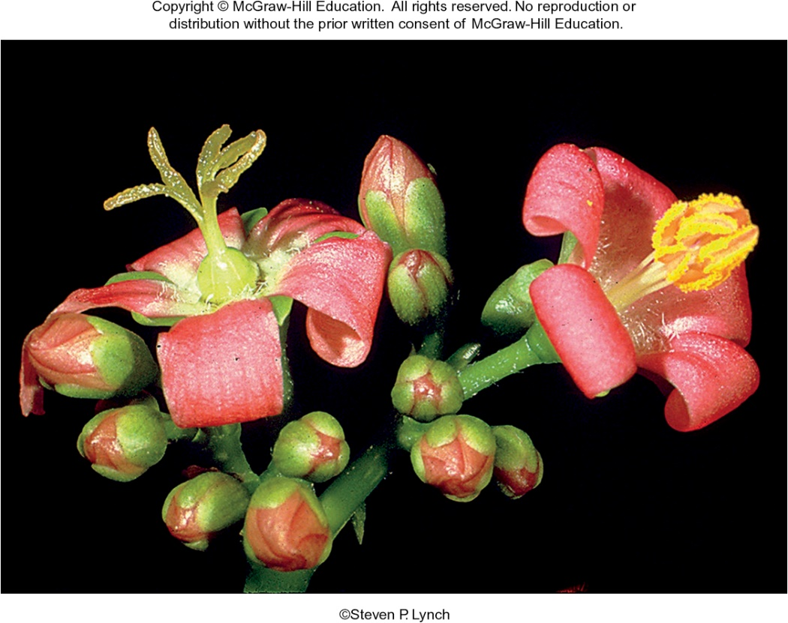
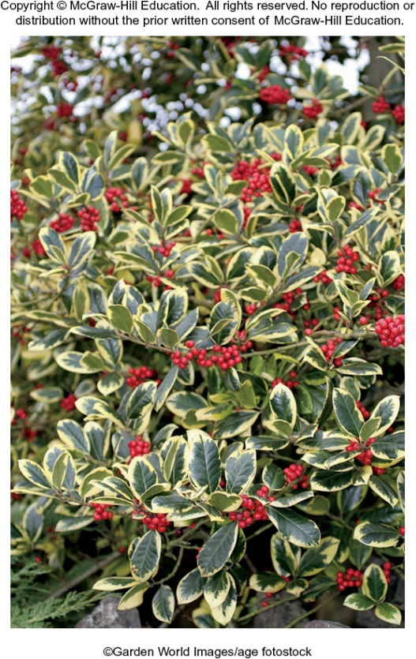
Monoecious and Dioecious Plants
Figure 27.4
(a): Steven P. Lynch; (b): Martin Hughes-Jones/Garden World Images/age fotostock

Slide 12
Development of Male Gametophyte
  Microspores are produced in anthers.
  Each anther has four pollen sacs, each with many microspore mother cells.
    Microspore mother cells undergo meiosis – produces four haploid microspores.
    Microspores undergo mitosis – produce pollen grains.
      The pollen gain is at first an immature gametophyte consisting of a tube cell and a generative cell.
      The tube cell divides to produce a pollen tube.
      The generative cell produces two sperm by mitosis.
      Finally, the pollen grain has become the mature male gametophyte.
Notes:
HOME NOTE
• Pollen grain

Slide 13
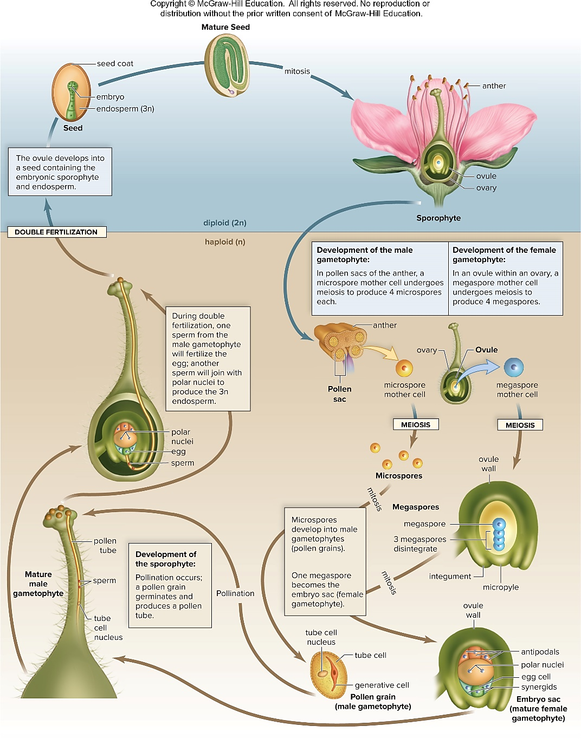
Life Cycle of Flowering Plants
Figure 27.5
Access the text alternative for slide images.

Slide 14
Development of Female Gametophyte
The ovary contains one or more ovules.
  An ovule has a central mass of parenchyma cells covered by integuments.
  One parenchyma cell enlarges to become a megaspore mother cell.
    The megaspore mother cell undergoes meiosis to produce four haploid megaspores, three of which are nonfunctional.
    The functional megaspore divides mitotically until there are eight nuclei in the female gametophyte.
  The female gametophyte (embryo sac) contains:
    One egg cell associated with two synergid cells
    One central cell with two polar nuclei
    Three antipodal cells
Notes:
HOME NOTE
• Ovule and embryo sac
Also write here:
– Flowering Plant Life Cycle 1 (23.5.86): The two polar nuclei are called "polar" because they come from opposite ends (poles) of the embryo sac.

Slide 15
Types of Pollination
  The transfer of pollen from an anther to the stigma of a carpel
    Self-pollination occurs if the pollen is from the same plant.
    Cross-pollination occurs if the pollen is from a different plant of the same species.
Notes:
HOME NOTE
• Pollination
Also write here:
– Seed Plants (23.5.55): In seed plants in general, pollination is wind or an animal pollinator carrying pollen toward the female gametophyte: onto the seed cone in pines, onto the stigma in flowering plants.

Slide 16
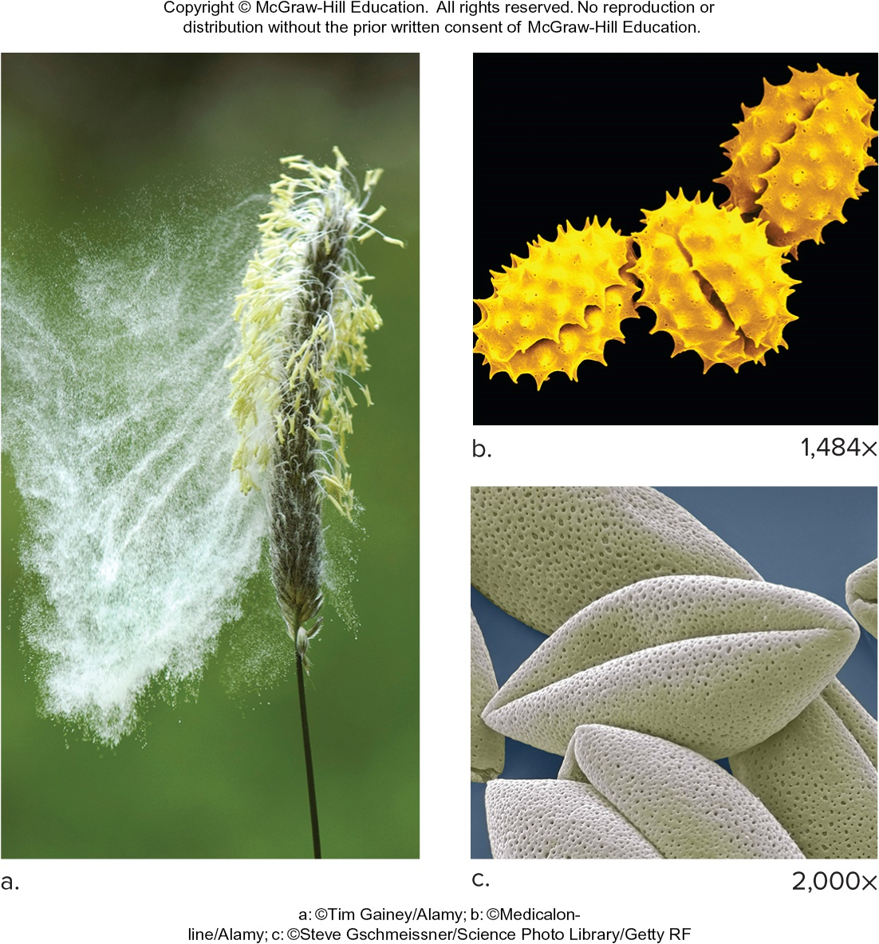
Pollination
Figure 27.6
(a): Tim Gainey/Alamy Stock Photo; (b): Mediscan/Alamy Stock Photo; (c): Steve Gschmeissner/Science Photo Library/Getty Images

Slide 17
Fertilization
  When a pollen grain lands on the stigma, it germinates, forming a pollen tube.
  The pollen tube passes between the stigma and style to reach the micropyle of the ovule.
  Double fertilization occurs
    One sperm nucleus unites with the egg nucleus, producing a 2n zygote.
    The other sperm nucleus unites with the polar nuclei, forming a 3n endosperm nucleus, which develops into the endosperm.
  A mature seed contains the embryo, stored food, and the seed coat.
Notes:
HOME NOTE
• Pollen tube
Also write here:
– Seed Plants (23.5.55): Sperm reach the female gametophyte through the pollen tube, so seed plants need no outside water for fertilization (unlike mosses and ferns, whose sperm must swim).
– Flowering Plant Life Cycle 2 (23.5.87): The pollen tube carries the two sperm to the micropyle, a small opening in the ovule.

Slide 18
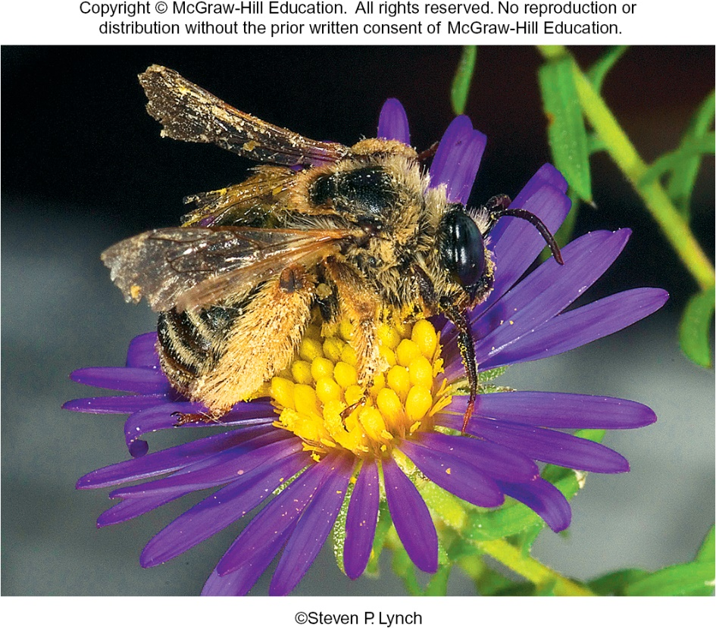
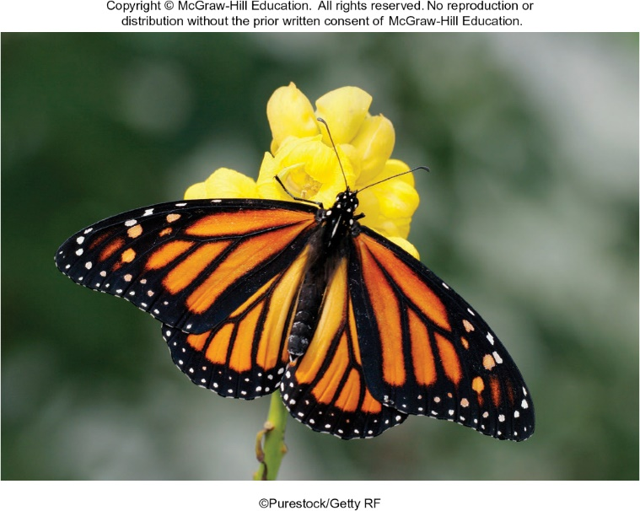
Insect Pollinators
Figure 27A
(a): Steven P. Lynch; (b): Purestock/Getty Images

Slide 19
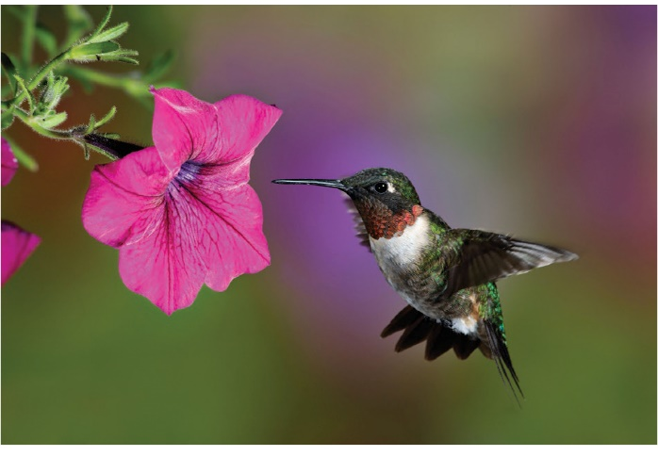
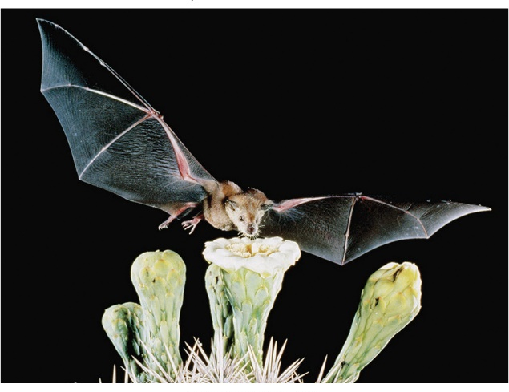
Bird and Bat Pollinators
Figure 27B
Access the text alternative for slide images.
(a): Daniel Dempster Photography/Alamy Stock Photo; (b): Merlin D. Tuttle/Science Source

Slide 20
27.2 Seed Development
  Development is a programmed series of stages from a simple to a more complex form.
  Cellular differentiation occurs as development proceeds.
  Development of a eudicot embryo
    After double fertilization, the zygote divides repeatedly to form a proembryo and a suspensor.
    The root-shoot axis has been established already.
  During the globular stage, the proembryo is a ball of cells.
    The outermost cells will become dermal tissue.
      Protects the plant from desiccation and include stomata

Slide 21
The Heart Stage and Torpedo Stage Embryos
  The embryo is heart-shaped when cotyledons appear.
  The embryo enlarges, elongates, and takes on a torpedo shape.
  The shoot apical meristem is responsible for aboveground growth.
  The root apical meristem is responsible for underground growth.

Slide 22
The Mature Embryo
  The epicotyl is the portion between cotyledons contributing to shoot development.
  The hypocotyl is the portion below that contributes to stem development.
  The radicle is the embryonic root.

Slide 23
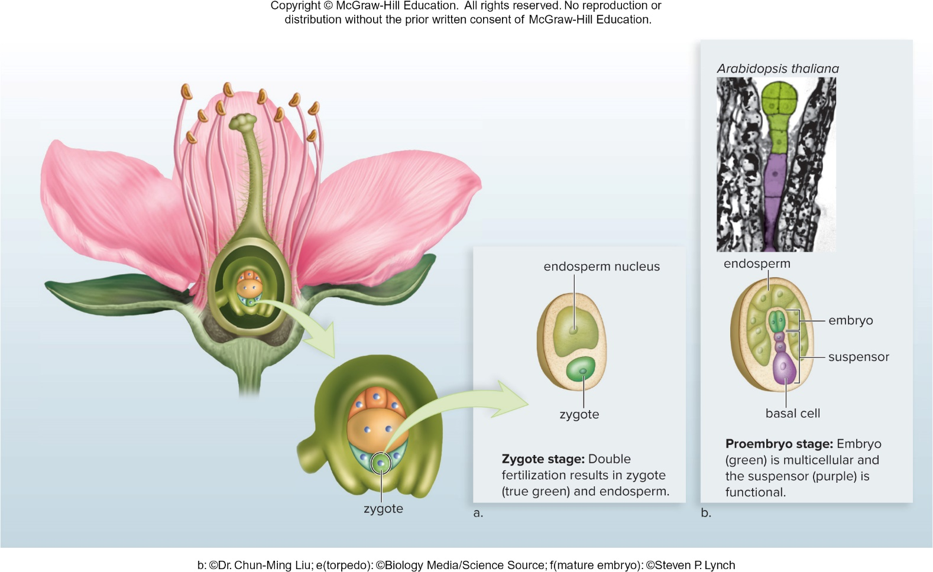
Development of a Eudicot Embryo 1
Figure 27.7
Access the text alternative for slide images.
(b): ©Dr. Chun-Ming Liu

Slide 24
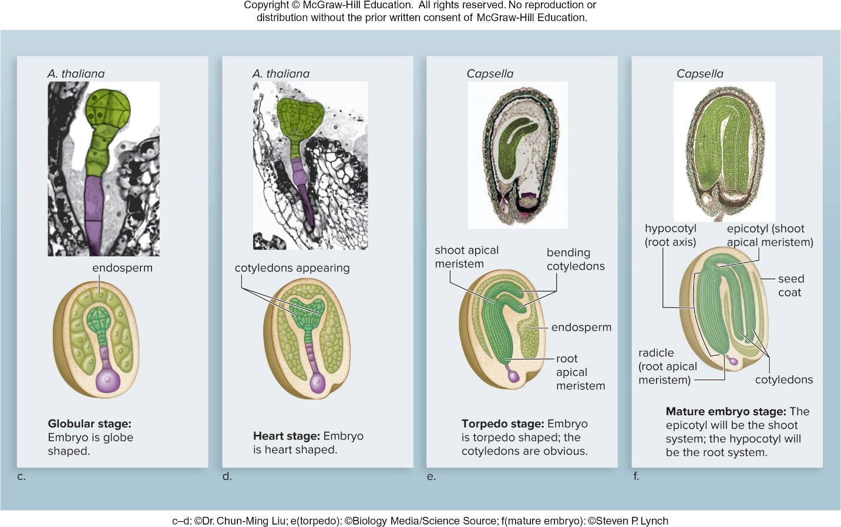
Development of a Eudicot Embryo 2
Figure 27.7
Access the text alternative for slide images.
(c to d): ©Dr. Chun-Ming Liu; (e): Biology Pics/Science Source; (f): Steven P. Lynch

Slide 25
Monocot Versus Eudicot Seeds
  Monocots have only one cotyledon.
  The monocot cotyledon stores certain nutrients, absorbs others from the endosperm, and passes them to the embryo.
  The eudicot cotyledons store all the nutrients the embryo needs.
    The endosperm is taken up by the two cotyledons.

Slide 26
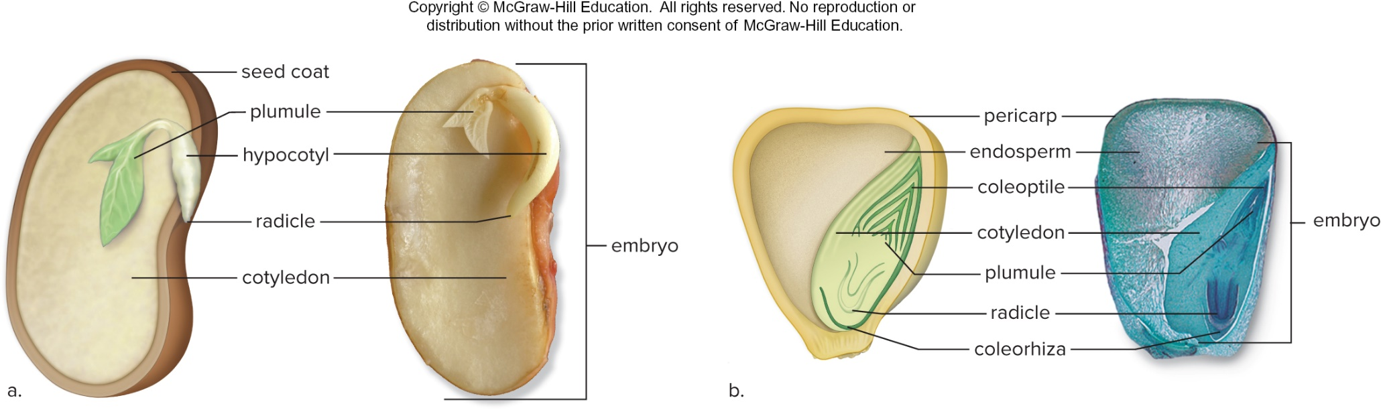
Monocot Versus Eudicot
Figure 27.8
Access the text alternative for slide images.
(photos): (bean): Robert and Jean Pollock/Science Source; (corn): ©Ray F. Evert/University of Wisconsin

Slide 27
27.3 Fruit Types and Seed Dispersal
A fruit is a mature ovary.
Simple Fruits
  Simple fruits are derived from a single ovary with one or several chambers.
Compound fruits develop from several groups of ovaries.
  Aggregate Fruits
    Ovaries are from a single flower one receptacle.
    Blackberry
  Multiple Fruits
    Ovaries are from separate flowers clustered together.
    Pineapple
Notes:
HOME NOTE
• Fruit
Also write here:
– Flowering Plant Life Cycle 3 (23.5.88): Some fruits give the seeds a moist, fleshy covering (apples); others give a dry covering (acorns).

Slide 28
Fruit Development
  The ovary wall thickens to become the pericarp, which can have three layers.
    The exocarp forms the outermost skin.
    The mesocarp is the fleshy tissue between the exocarp and the endocarp.
    The endocarp is the boundary around the seeds.

Slide 29
Fruit Types
  In dry fruits, the pericarp is paper, leathery, or woody when the fruit is mature.
    Dehiscent – The fruit splits open when ripe
      Legumes
    Indehiscent – The fruit does not split open when ripe
      Grains

Slide 30
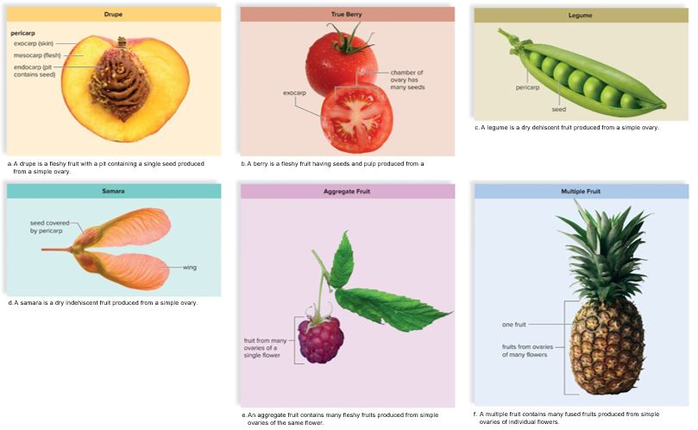
Fruits
Figure 27.9
Access the text alternative for slide images.
(a): ©Peter Fakler/Alamy Stock Photo; (b): D. Hurst/Alamy Stock Photo; (c): Danny Smythe/Shutterstock; (d): Robert Llewellyn/Corbis/Getty Images; (e): Ricochet Creative Productions LLC; (f): Ingram Publishing/Alamy Stock Photo

Slide 31
Dispersal of Fruits
  Many dry fruits are dispersed by wind.
    Woolly hairs, plumes, wings
  Many fruits attract animals and provide them with food.
    Peaches, cherries, tomatoes
  Hooks and spines attach a dry fruit to animal fur and human clothing.
  Plants with dehiscent fruits disperse their seeds by forced ejection.
Notes:
HOME NOTE
• Fruit and seed dispersal
Also write here:
– Flowers and Diversification (23.5.90): Fruits protect seeds and help spread them using wind, gravity, water and animals.

Slide 32
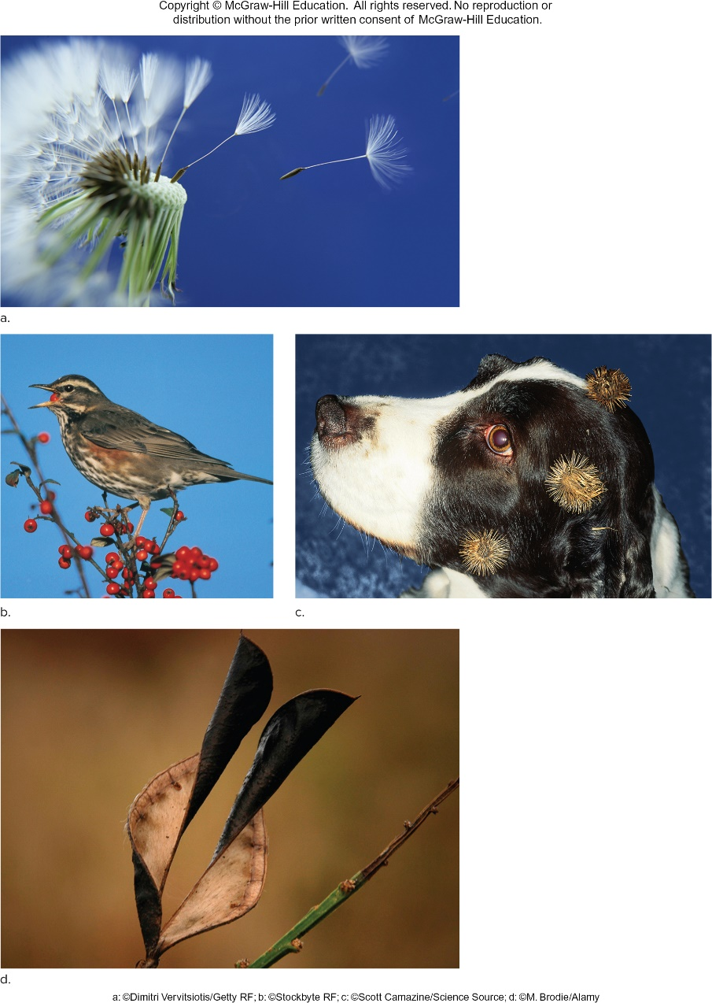
Methods of Fruit and Seed Dispersal
Figure 27.10
Access the text alternative for slide images.
(a): Dimitri Vervitsiotis/Getty Images; (b): Stockbyte/ Getty Images; (c): Scott Camazine/Science Source; (d): M. Brodie/Alamy Stock Photo

Slide 33
Seed Germination
  When seed germination occurs, the embryo resumes growth and metabolic activity.
  Length of time seeds retain their viability is quite variable.
  Some seeds do not germinate until they have been through a dormant period.
    No growth occurs
      Temperate zones – Cold weather breaks dormancy
      Fleshy fruits contain inhibitors to prevent germination when the fruit is on the plant.
Notes:
HOME NOTE
• Dormancy
Also write here:
– Evolution of Seed Plants: Full Adaptation to Land (23.5.54): A seed's coat and stored food are what let the embryo survive harsh conditions through long periods of dormancy.

Slide 34
Germination Requirements
  Availability of oxygen for metabolic needs
  Adequate warmth for enzyme activity
  Adequate water for hydration of cells

Slide 35
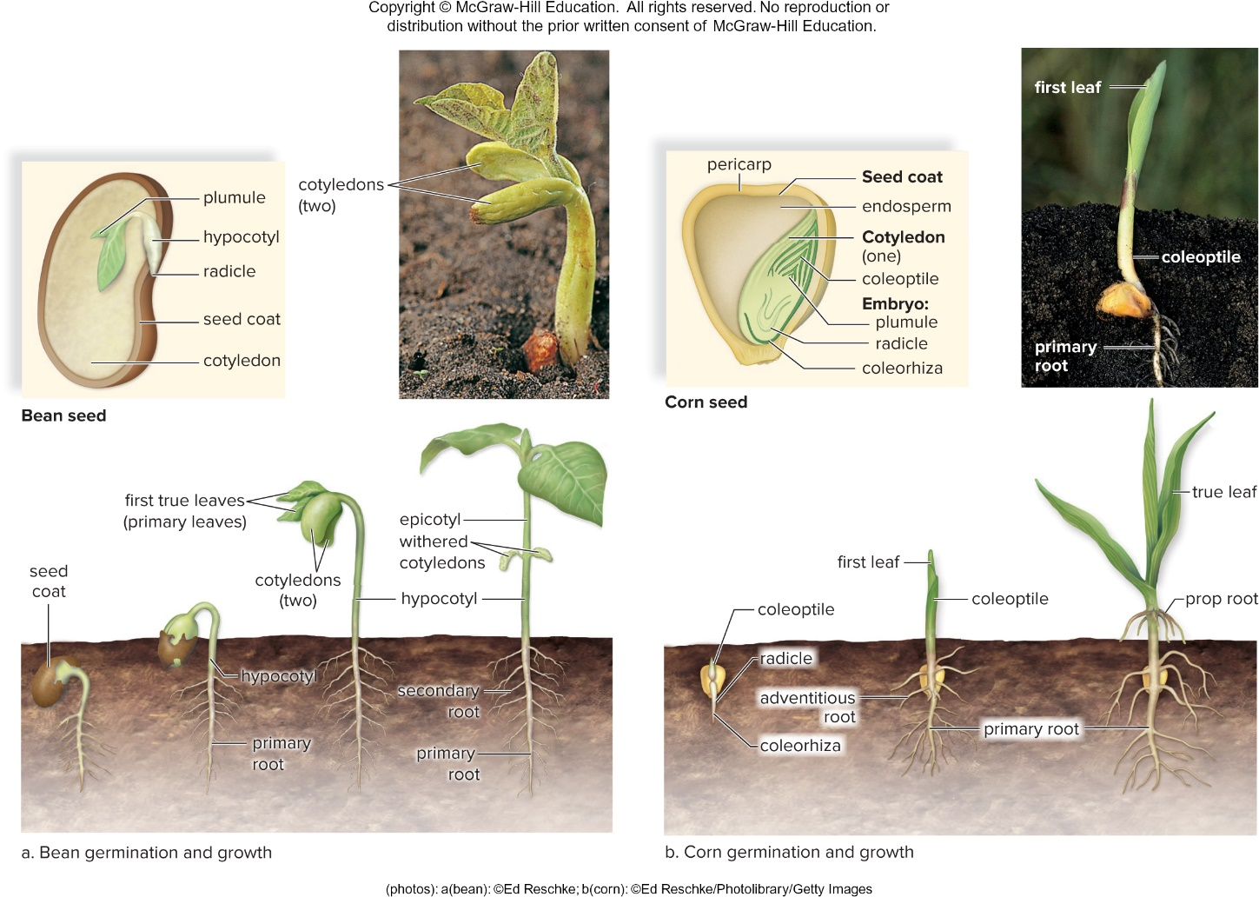
Eudicot and Monocot Seed Germination
Bean germination and growth
Corn germination and growth
Figure 27.11
Access the text alternative for slide images.
(photos): (bean): Ed Reschke; (corn): Ed Reschke/Stone/Getty Images

Slide 36
27.4 Asexual Reproductive Strategies
Plants can reproduce asexually with the use of:
  Stolons – Horizontal stems that run aboveground
  Rhizomes – Underground stems that produce new plants asexually
  Nodes of stems are regions where new growth can occur.
    New plants arise at the nodes of stolons and rhizomes.
    The “eyes” of white potatoes are buds that can produce a new plant if planted with a portion of the tuber (rhizome).

Slide 37
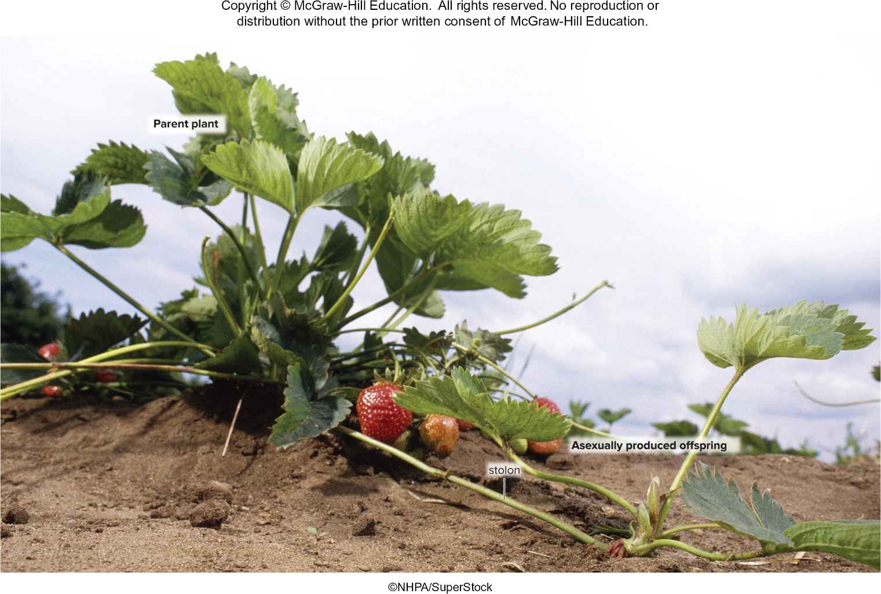
Asexual Reproduction in Plants
Figure 27.12
NHPA/SuperStock

Slide 38
Tissue Culture of Plants
Tissue culture is the growth of a tissue in an artificial liquid or solid culture medium.
  Many plant cells are totipotent.
    Each has the genetic capability of becoming an entire plant

Slide 39
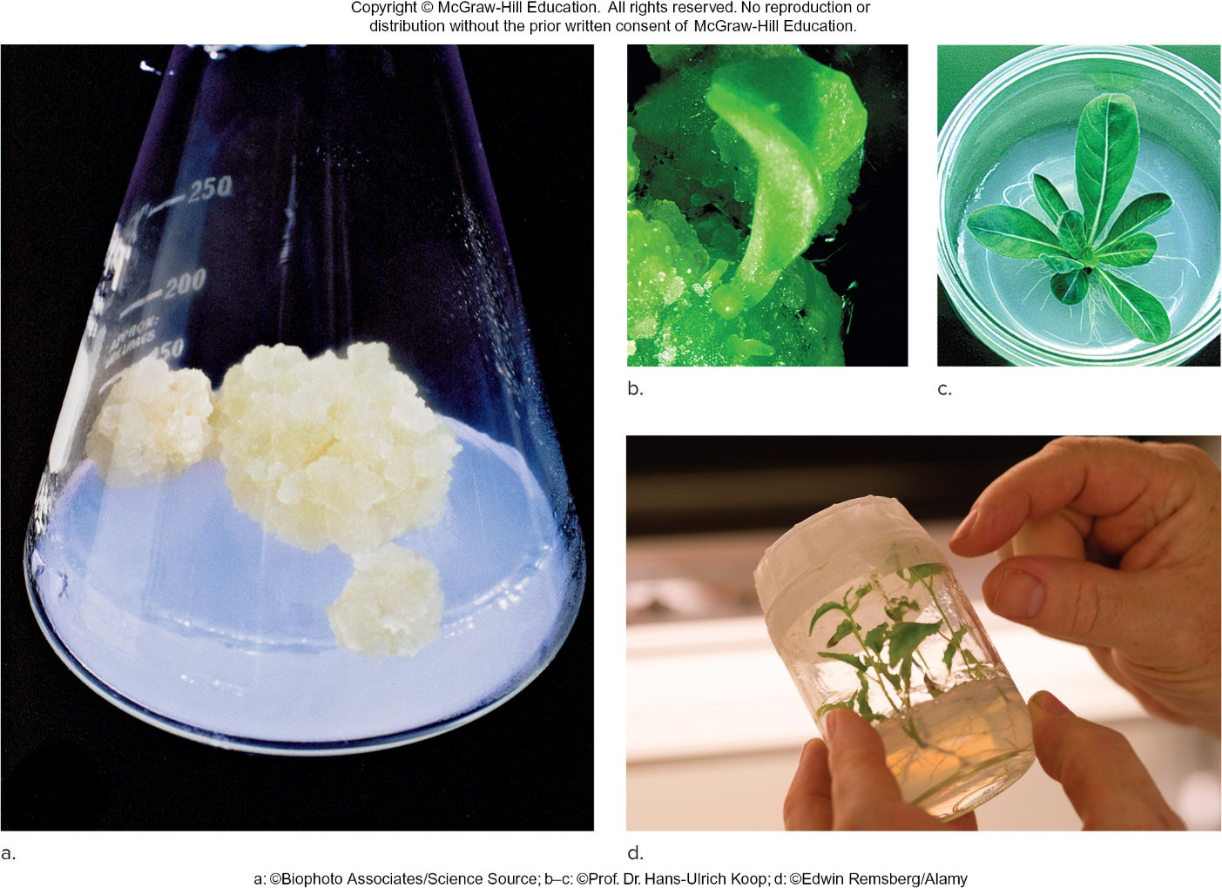
Asexual Reproduction Through Tissue Culture
Figure 27.13
Access the text alternative for slide images.
(a): Biophoto Associates/Science Source; (b—c): Courtesy Prof. Dr. Hans-Ulrich Koop from Plant Cell Reports, 17:601—604; (d): Edwin Remsberg/Alamy Stock Photo

Slide 40
Tissue Culture and Cell
Suspension Culture
Meristem tissue
  Results in clonal plants with identical traits
  Grown in medium containing auxin, cytokinins, and nutrients
  Undifferentiated cells called a callus form first.
  Organogenesis results and initiates root and shoot formation.
  Finally, a plantlet is formed.
Cell Suspension Culture
  Rapidly growing calluses are cut into small pieces and shaken into a liquid nutrient medium.
    Single cells or small clumps break off and form a suspension.
    Chemicals can be extracted from genetically modified plant cells.
    Digitalis species produce drugs used to treat heart disease.
    Avoids overcollection of wild plants from native environments

Slide 41
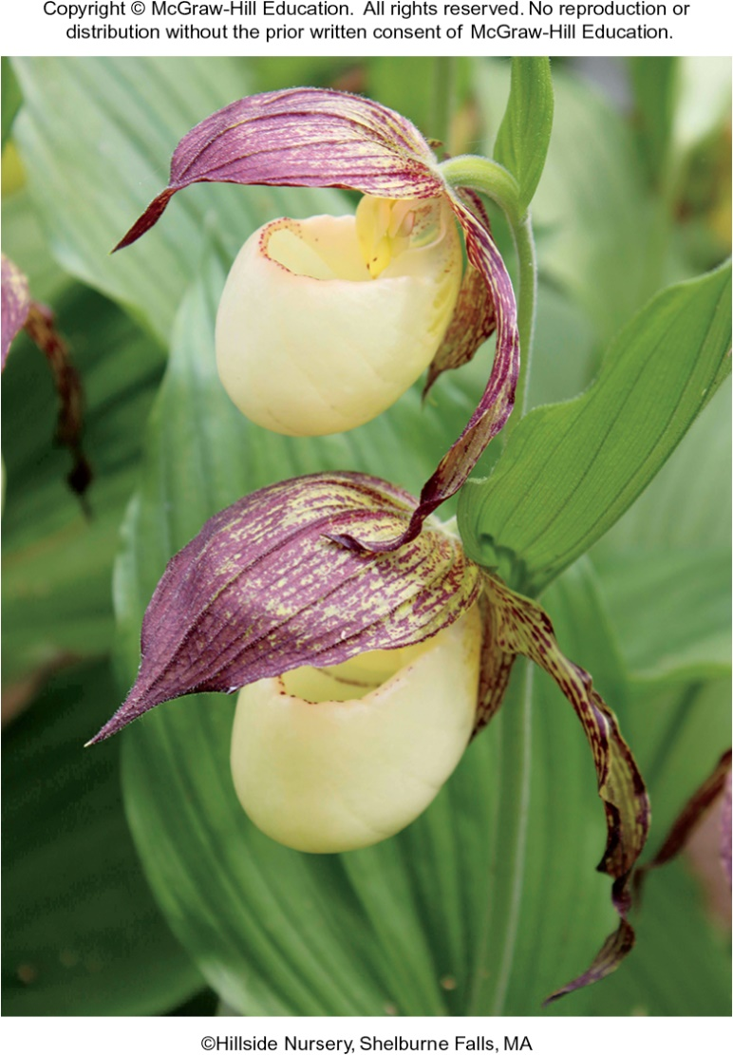
Tissue Culture for Plant Conservation
Figure 27.14
©Hillside Nursery, Shelburne Falls, MA

Slide 42
End of main content
Copyright 2022 © McGraw Hill LLC. All rights reserved. No reproduction or distribution without the prior written consent of McGraw Hill LLC.

Slide 43
Accessibility Content: Text Alternatives for Images

Slide 44
Sexual Reproduction in Flowering Plants - Text Alternative
Return to parent-slide containing images.
The sporophyte bears flowers. The flower produces microspores within anthers and megaspores within ovules by meiosis. A megaspore becomes a female gametophyte, which produces an egg within an embryo sac, and a microspore becomes a male gametophyte (pollen grain), which produces sperm. Fertilization results in a zygote. A seed contains an embryo and stored food within a seed coat. After dispersal, a seed becomes a new sporophyte plant.
Return to parent-slide containing images.

Slide 45
Monocot Versus Eudicot Flowers - Text Alternative
Return to parent-slide containing images.
a) In Daylily, Hemerocallis sp., there are one carpel, one stamen, three petals, and three sepals.
b) In Festive azalea, Rhododendron sp., there is one carpel, one stamen, five petals, and no sepals.
Return to parent-slide containing images.

Slide 46
Life Cycle of Flowering Plants - Text Alternative
Return to parent-slide containing images.
The cycle from double fertilization to meiosis is as follows:
The ovule develops into a seed containing the embryonic sporophyte and endosperm.
Seed consists of a seed coat, embryo and endosperm (3n). This leads to maturation of seed leading to mitosis and finally to sporophyte, pollen sac and ovule.
The data for development of the male gametophyte and development of the female gametophyte are as follows:
In pollen sacs of the anther, a microspore mother cell undergoes meiosis to produce four microspores: In an ovule within an ovary, a megaspore mother cell undergoes meiosis to produce four megaspores.
The cycle from meiosis to double fertilization is as follows:
Meiosis leads to leads to megaspores leading to mitosis which lead to embryo sac (mature female gametophyte) finally leading to mature male gametophyte.
Development of the sporophyte:
Pollination occurs; a pollen grain germinates and produces a pollen tube.
This leads to double fertilization.
During double fertilization, one sperm from the male gametophyte will fertilize the egg; another sperm will join with polar nuclei to produce the 3n endosperm.
Meiosis leads to microspores leading to mitosis.
Microspores develop into male gametophytes (pollen grains). One megaspore becomes the embryo sac (female gametophyte).
This leads to pollen grain (male gametophyte) leading to pollination which finally leads to mature male gametophyte leading to double fertilization.
During double fertilization, one sperm from the male gametophyte will fertilize the egg; another sperm will join with polar nuclei to produce the 3n endosperm.
Return to parent-slide containing images.

Slide 47
Bird and Bat Pollinators - Text Alternative
Return to parent-slide containing images.
Hummingbird-pollinated flowers are curved back, allowing the bird to insert its beak to reach the rich supply of nectar. While doing this, the bird’s forehead and other body parts touch the reproductive structures.
Bat-pollinated flowers are large, sturdy flowers that can take rough treatment. Here, the head of the bat is positioned so its bristly tongue can lap up nectar.
Return to parent-slide containing images.

Slide 48
Methods of Fruit and Seed Dispersal - Text Alternative
Return to parent-slide containing images.
They are:
1. Dandelion fruits float away on air currents.
2. A bird eating fleshy fruits.
3. Burdock, a dry fruit, clinged to the fur of a dog.
4. A split open dry pod, forcibly ejecting its seeds.
Return to parent-slide containing images.

Slide 49
Development of a Eudicot Embryo 1 - Text Alternative
Return to parent-slide containing images.
Zygote stage:
Diagram shows an ovular zygote and irregularly circular endosperm nucleus.
Double fertilization results in zygote (true green) and endosperm.
Proembryo stage:
Diagram shows an ovular basal cell, segmented suspensor, embryo and endosperm.
Embryo (green) is multicellular and the suspensor (purple) is functional.
Return to parent-slide containing images.

Slide 50
Development of a Eudicot Embryo 2 - Text Alternative
Return to parent-slide containing images.
C) A. thaliana:
Cutaway diagram of seed shows curved and segmented endosperm.
Globular stage:
Embryo is globe shaped.
D) A. thaliana:
Cutaway diagram of seed shows cotyledons appearing.
Heart stage: Embryo is heart shaped.
E) Capsella:
Cutaway diagram of seed shows shoot apical meristem, bending cotyledons, endosperm and root apical meristem.
Torpedo stage: Embryo is torpedo shaped; the cotyledons are obvious.
F) Capsella:
Cutaway diagram of seed shows hypocotyl (root axis), epicotyl (shoot apical meristem), seed coat, radicle (root apical meristem) and cotyledons.
Mature embryo stage:
The epicotyl will be the shoot system; the hypocotyl will be the root system.
Return to parent-slide containing images.

Slide 51
Asexual Reproduction Through Tissue Culture - Text Alternative
Return to parent-slide containing images.
a. A conical flask containing medium shows a meristem tissue placed on the top. b. From the callus, organogenesis takes place and leaves or roots develop. c. The callus develops into a plantlet. d. Plantlets can be stored in a sterile container.
Return to parent-slide containing images.

Slide 52
Monocot Versus Eudicot - Text Alternative
Return to parent-slide containing images.
A) A longitudinally sectioned diagram shows a monocot embryo seed coat, leaf-like plumule and hypocotyl, radicle tip and cotyledon.
B) A longitudinally sectioned diagram shows an external pericarp layer, inner endosperm, segments of coleoptile, leaf-like cotyledon, plumule, curved segments of radicle and elongated coleorhiza.
Return to parent-slide containing images.

Slide 53
Fruits - Text Alternative
Return to parent-slide containing images.
A. a drape is a fleshy fruit with a pit containing a single seed produced from a simple ovary. B. A berry is a fleshy fruit having seeds and pulp produced from a compound ovary. C. a legume is a dry dehiscent fruit produced from a single ovary. D. A samara is a dry indehiscent fruit produced from a simple ovary. E. An aggregate fruit contains many fleshy fruits produced from simple ovaries of the same flower. F. A multiple fruit contains many fused fruits produced from simple ovaries of individual flowers.
Return to parent-slide containing images.

Slide 54
Eudicot and Monocot Seed Germination - Text Alternative
Return to parent-slide containing images.
A) Bean seed (with two cotyledons):
Diagram shows leaf shaped plumule and hypocotyl, radicle, external seed coat and internal cotyledon.
It shows four stages of bean germination and growth:
1. Seed coat appears.
2. Hypocotyl and primary root appears.
3. First true leaves (primary leaves) and cotyledons (two) appears.
4. Epicotyl withered cotyledons, hypocotyl, secondary root and primary root appears.
B) Corn seed (with first leaf, coleoptile and primary root):
Diagram shows an external pericarp layer, inner endosperm, inside a seed coat, one cotyledon with segments of coleoptile, plumule, curved segments of radicle and elongated coleorhiza.
It shows three stages of corn germination and growth:
1. Coleoptile, radicle and coleorhiza appears.
2. First leaf, coleoptile, adventitious root and primary root appears.
3. True leaf, prop root and primary root appears.
Return to parent-slide containing images.

